Slide 1
Data Science
CSE-4075
(Simple Linear Regression)

Slide 2
Art, like morality, consists in drawing the line somewhere.
G. K. Chesterton

Slide 3
Deterministic vs Statistical Relationship
Relationship between two variables is said to be deterministic if one variable can be accurately expressed by the other
Celsius → Fahrenheit
Statistical relationship is not accurate in determining relationship between two variables
Height → Weight

Slide 4
Regression model
Statistical relation between variables where changes in some variables may “explain” or possibly “cause” changes in other variables.
Explanatory variables are termed the independent variables and the variables to be explained are termed the dependent variables.
Regression model estimates the nature of the relationship between the independent and dependent variables.
Change in dependent variables that results from changes in independent variables, i.e. size of the relationship.
Strength of the relationship.
Statistical significance of the relationship.

Slide 5
Examples
Dependent variable is retail price of gasoline in Regina – independent variable is the price of crude oil.
Dependent variable is employment income – independent variables might be hours of work, education, occupation, gender, age, region, years of experience, unionization status, etc.
Price of a product and quantity produced or sold:
Quantity sold affected by price. Dependent variable is quantity of product sold – independent variable is price.
Price affected by quantity offered for sale. Dependent variable is price – independent variable is quantity sold.

Slide 6
Bivariate and multivariate models
(Education) x y (Income)
(Education) x₁
(Gender) x₂
(Experience) x₃
(Age) x₄
Bivariate or simple regression model
Multivariate or multiple regression model
y (Income)
Model with simultaneous relationship
Price of wheat
Quantity of wheat produced

Slide 7
Simple linear regression
x is the independent variable
y is the dependent variable
The regression model is
The model has two variables, the independent or explanatory variable, x, and the dependent variable y, the variable whose variation is to be explained.
The relationship between x and y is a linear or straight line relationship.
Two parameters to estimate – the slope of the line β₁ and the y-intercept β₀ (where the line crosses the vertical axis).
ε is the unexplained, random, or error component. Much more on this later.

Slide 8
Regression line
The regression model is
Data about x and y are obtained from a sample.
From the sample of values of x and y, estimates b₀ of β₀ and b₁ of β₁ are obtained using the least squares or another method.
The resulting estimate of the model is
The symbol is termed “y hat” and refers to the predicted values of the dependent variable y that are associated with values of x, given the linear model.

Slide 9
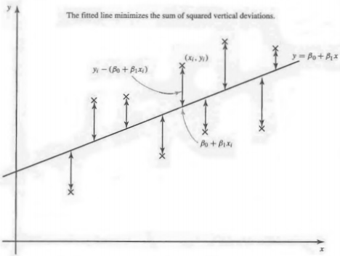
Regression line
The core idea is to obtain a line that best fits the data
The best fit line is the one for which total prediction error (all data points) are as small as possible
Error is the distance between the point to the regression line

Slide 10
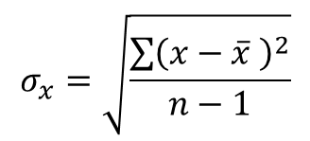
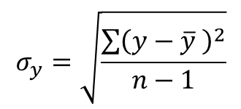
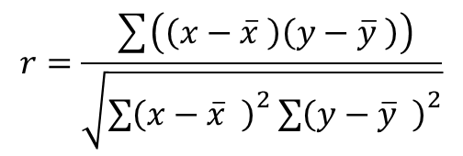
Parameters
Slope of Regression Line:
$$σ_{y}=\sqrt{\frac{\sum{{\left(y−\overline{y} \right)}^{2}}}{n−1}}$$
$$r=\frac{\sum{\left(\left(x−\overline{x} \right)\left(y−\overline{y} \right)\right)}}{\sqrt{{\sum{\left(x−\overline{x} \right)}}^{2}{\sum{\left(y−\overline{y} \right)}}^{2}}}$$
$$σ_{x}=\sqrt{\frac{\sum{{\left(x−\overline{x} \right)}^{2}}}{n−1}}$$
Y intercept of Regression Line:

Slide 11
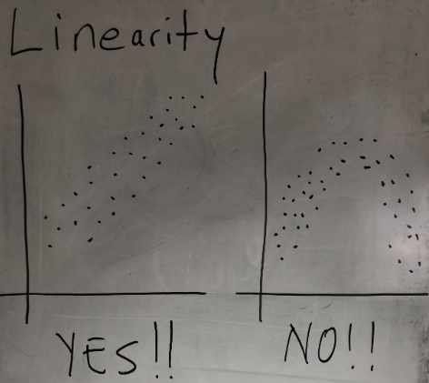
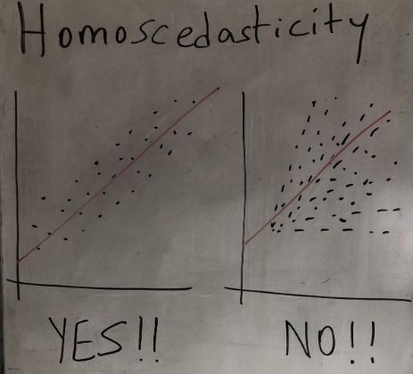
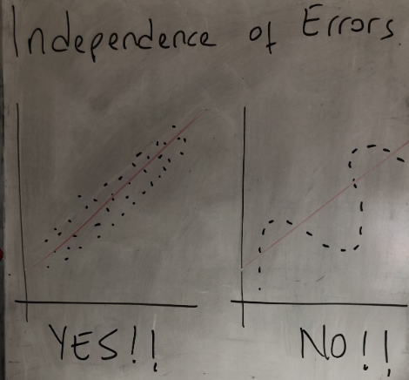
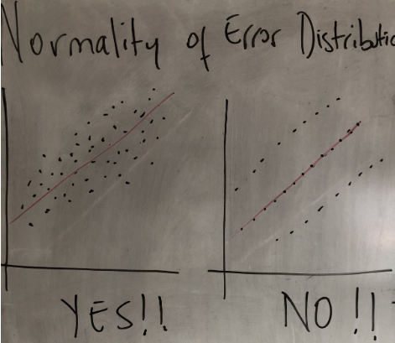
When to apply Linear Regression?

Slide 12
Example
MONTH | PRODUCTION (X) | ELECTRICITY USAGE (Y)
January | 4.51 | 2.48
February | 3.58 | 2.26
March | 4.31 | 2.47
April | 5.06 | 2.77
May | 5.64 | 2.99
June | 4.99 | 3.05
July | 5.29 | 3.18
August | 5.83 | 3.46
September | 4.70 | 3.03
October | 5.61 | 3.26
November | 4.90 | 2.67
December | 4.20 | 2.53

Slide 13
Parameters Calculation
 | X | Y | (𝑥−𝑥 ̅) | (y-y ̅) | (𝑥−𝑥 ̅)(y-y ̅) | (x-x ̅ )^2 | (𝑦−𝑦 ̅ )^2
 | 4.51 | 2.48 | -0.375 | -0.36583 | 0.1371875 | 0.140625 | 0.133834
 | 3.58 | 2.26 | -1.305 | -0.58583 | 0.7645125 | 1.703025 | 0.343201
 | 4.31 | 2.47 | -0.575 | -0.37583 | 0.216104167 | 0.330625 | 0.141251
 | 5.06 | 2.77 | 0.175 | -0.07583 | -0.013270833 | 0.030625 | 0.005751
 | 5.64 | 2.99 | 0.755 | 0.144167 | 0.108845833 | 0.570025 | 0.020784
 | 4.99 | 3.05 | 0.105 | 0.204167 | 0.0214375 | 0.011025 | 0.041684
 | 5.29 | 3.18 | 0.405 | 0.334167 | 0.1353375 | 0.164025 | 0.111667
 | 5.83 | 3.46 | 0.945 | 0.614167 | 0.5803875 | 0.893025 | 0.377201
 | 4.7 | 3.03 | -0.185 | 0.184167 | -0.034070833 | 0.034225 | 0.033917
 | 5.61 | 3.26 | 0.725 | 0.414167 | 0.300270833 | 0.525625 | 0.171534
 | 4.9 | 2.67 | 0.015 | -0.17583 | -0.0026375 | 0.000225 | 0.030917
 | 4.2 | 2.53 | -0.685 | -0.31583 | 0.216345833 | 0.469225 | 0.099751
Sum | 58.62 | 34.15 |  |  | 2.43045 | 4.8723 | 1.511492
Average | 4.885 | 2.845833
 |  |  |  |  |  |  | sigma_y= | 0.370686
 |  |  |  |  | r= | 0.895606 | sigma_x= | 0.665535 |  | beta_1= | 0.49883
 |  |  |  |  |  |  |  |  |  | beta_0= | 0.409048

Slide 14
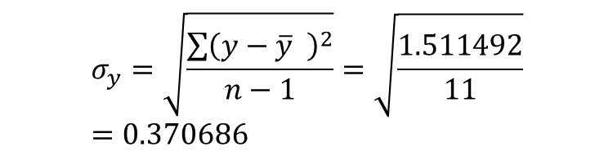

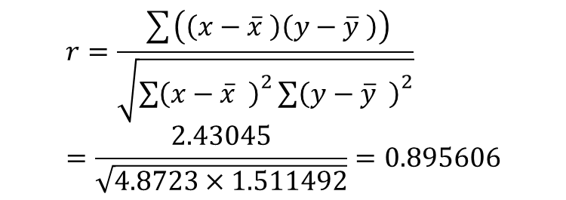
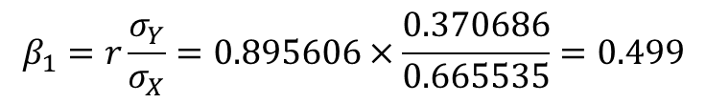
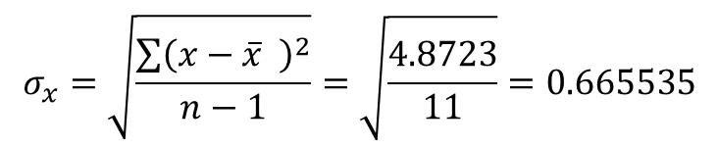
Parameters Calculation
$$σ_{y}=\sqrt{\frac{\sum{{\left(y−\overline{y} \right)}^{2}}}{n−1}}=\sqrt{\frac{1.511492}{11}}=0.370686$$
$$r=\frac{\sum{\left(\left(x−\overline{x} \right)\left(y−\overline{y} \right)\right)}}{\sqrt{{\sum{\left(x−\overline{x} \right)}}^{2}{\sum{\left(y−\overline{y} \right)}}^{2}}}=\frac{2.43045}{\sqrt{4.8723×1.511492}}=0.895606$$
$$σ_{x}=\sqrt{\frac{\sum{{\left(x−\overline{x} \right)}^{2}}}{n−1}}=\sqrt{\frac{4.8723}{11}}=0.665535$$
$$β_{1}=r\frac{σ_{Y}}{σ_{X}}=0.895606×\frac{0.370686}{0.665535}=0.499$$
$$β_{0}=\overline{Y}−β_{1}\overline{X}=2.845833−0.499×4.885=0.409$$
$$Y=β_{0}+β_{1}x=0.409+0.499x$$

Slide 15
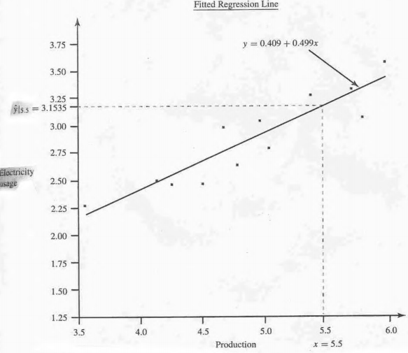

Slide 16
Notes:
The role of the two significant observations

Slide 17
Outliers
Rare, extreme values may distort the outcome.
Could be an error.
Could be a very important observation.
Outlier: more than 3 standard deviations from the mean.
Notes:
If you see one, check if it is a mistake.

Slide 18
Notes:
The role of the two significant observations

Slide 19
Notes:
The role of the two significant observations

Slide 20
Implementation
import statsmodels.api as sm
from sklearn import datasets ## imports datasets from scikit-learn
data = datasets.load_boston() ## loads Boston dataset from datasets library
import pandas as pd
# define the data/predictors as the pre-set feature names
df = pd.DataFrame(data.data, columns=data.feature_names)
# Put the target (housing value -- MEDV) in another DataFrame
target = pd.DataFrame(data.target, columns=["MEDV"])
X = df[["RM", "LSTAT"]] ## X usually means our input variables (or independent variables)
y = target["MEDV"] ## Y usually means our output/dependent variable
X = sm.add_constant(X) ## let's add an intercept (beta_0) to our model
# Note the difference in argument order
model = sm.OLS(y, X).fit() ## sm.OLS(output, input)
predictions = model.predict(X)
# Print out the statistics
model.summary()

